Slide 1
Launching Regional Digital Payments Platform Background: Your client is a midsize fintech firm headquartered in Singapore. They’ve built a mobile-first digital wallet used by 200,000 users in Singapore, and now want to expand into Indonesia.
Prepared by – Sachin Garje

Slide 2
Agenda
Market Sizing & Segmentation
Competitive Landscape
Customer Needs & Adoption Barriers
Value Proposition & Positioning
Channel & Partnership Strategy
Pricing & Monetization
Key Metrics & Launch Roadmap
Prepared by – Sachin Garje

Slide 3
Indonesia's mobile wallet TAM reaches $508M by 2025, with urban middle and high-income users representing ~85% of near-term opportunity
Estimating TAM for mobile wallets in Indonesia (2025)
Source-backed Data
Assumptions
Population and penetration figures are sourced directly from BPS Indonesia and the APJII Survey 2025, not estimated.
Wallet adoption rates reflect real-world income-linked behavior. Urban high-income users are assumed to adopt wallets at 60% — consistent with GoPay's published regional adoption data.
Monthly ARPU is derived from three revenue streams: e-commerce wallet share (~$0.18), QRIS daily transactions at Bank Indonesia's standard 0.7% MDR (~$0.14), and value-added services like BNPL/credit commissions (~$0.20).
Assumptions
Indonesia Population
284.4 M
Urban : 60%
170.7 M
Rural : 40%
113.8 M
Smartphone penetration: 74%
126.5 M
Smartphone penetration : 61%
69.2 M
Internet penetration : 84%
105.7 M
Internet penetration : 77%
53.2 M
Key Takeaways
92% of total TAM comes from urban cities. The urban market is more accessible because merchant density, smartphone penetration, and digital payment habits already exist. Rural is a long-term inclusion play, not a launch market.
Urban middle and high-income users represent ~85% of near-term revenue driven by high adoption rates and ARPU.
ARPU growth is the real lever, not user volume. The difference between a low- and high-income urban wallet user is roughly 5× in monthly revenue ($0.35 vs. $1.85). As users move up the income ladder, wallet rev per user compounds.
 | Income | Wallet | ARPU/month
Low | 40% | 20% | $0.35
Mid | 40% | 40% | $0.75
High | 20% | 60% | $1.85
 | Income | Wallet | ARPU/month
Low | 50% | 5% | $0.12
Mid | 40% | 30% | $0.25
High | 10% | 50% | $0.55
X
X
X
X
Urban TAM
$469.3 M
Rural TAM
$38.6 M
Total TAM
$507.9 M
*ARPU – Annual Revenue Per User
Sources: BPS-Statistics Population, Urban Population, Smartphone Penetration, Internet Penetration, Income Split, GoPay Regional Adoption Rates, PCMI
Prepared by – Sachin Garje

Slide 4
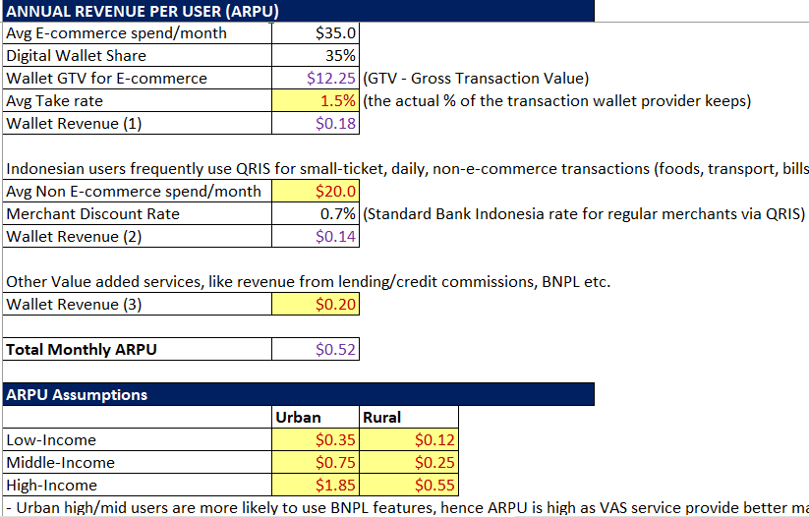
Snapshot from Excel Spreadsheet – ARPU Calculation
Prepared by – Sachin Garje

Slide 5
GoPay, OVO, and DANA collectively cover 80%+ of the market — but each is anchored to a single ecosystem, leaving gaps in neutral, cross-platform users
 | GoPay | OVO | DANA
Parent Company | GoTo Group | Grab | Emtek + Ant Financial
Usage rates | 71 - 88% | 70 - 78% | 61 - 83%
Registered Users | 60+ million | ~115 M devices | 140-180 million
Monthly Active Users | 18.1 million | 21.5 million | 58.7 million
Core value proposition | Integrated with Gojek super app ecosystem | Rewards system – OVO points redeemable in cash | Indonesia's "Alipay" – positioned as open platform, wallet for financial management
Use cases | Mobility-linked, delivery and commerce | Ecommerce buyers, offline purchase in major retail chains | Digital wallet for everyday Indonesians – utilities, retail, online marketplace
Regulatory ties | All three licensed as e-money issuers by Bank Indonesia, QRIS compliant, involved in Government programs (Kartu Prakerja initiative, PEN-Pemulihan Ekonomi Nasional)
Strengths | Strongest merchant network 900,000+ Sharia-compliant savings AI voice assistant Dira Offers financing solutions like GoPay Borrow and GoPay Later | Strongest loyalty program in market Best offline merchant networks OVO collaborates with Superbank to deliver deposit, loan, and investment products. | Cross-border payment support in Malaysia, Singapore, and Thailand Offers a range of services from investment access to bill splitting.
Weakness | Ecosystem dependent (Gojek–Tokopedia) Functionality only limited to Indonesian market | OVO's user presence has remained stable – flat growth is a concern in a market still expanding rapidly. Rewards model is expensive to sustain | No proprietary super-app to drive organic daily habit Dependent on third-party integrations (tiket.com) for transaction frequency
No single player exceeds ~25% market share. The market remains genuinely contestable — but entry requires QRIS compliance, OJK licensing, and a clear answer to the question: 'Why would a user open a 4th wallet?
Sources: User engagement trends, Usage rates, Wallet share, GoPay statistics, Snapshot of top e-wallets in Indonesia, Top digital payment methods, Indonesia mobile wallet market assessment, MAUs
Prepared by – Sachin Garje

Slide 6
Security, Reliability and Onboarding are the three friction points incumbents have failed to solve — validate these via primary research before finalizing GTM positioning
Data Security and Fraud
Across GoPay, OVO, and Dana, security emerged as the single highest-priority improvement factor in user satisfaction research.
Issues like sudden balance deduction; cyberattacks such as phishing and OTP fraud were a major concern.
Wallets are optimized for transaction speed and frequency—security layer gets lost in the UX noise.
Primary Research Methods to Consider
Quantitative survey to size the scale of consumer pain points in existing offerings.
Platform: JakPat or Populix
Sample: 300-400 respondents
Output: Prioritized pain points ranking with statistical significance.
Qualitative survey to understand the improvement areas and feed product roadmap plans.
Platform: Populix or local agency
Sample: 15-20 depth interviews
Output: Verbatim quotes + specific data points on building trust and transparency.
Reliability & Customer Support
Customer service provide generic responses rather than resolving actual financial discrepancies.
A “successful but missing" transaction problem creates a massive trust crisis between the user and the platform.
Frequent crashes and login failures during busy hours raises serious reliability concerns.
Consumer Pain Points
Onboarding & Verification
Delays in the e-KYC process prevent users from accessing core features like transfers or higher balance limits, leading to early abandonment of the app.
Users often face technical glitches during document uploads (like ID photos) creating a "bottleneck" at the very start of the user journey.
Sources: Study on user satisfaction in Indonesia’s e-wallet market, Study on Challenges and Perceptions, Study on adoption of e-wallet in Indonesia
Prepared by – Sachin Garje

Slide 7


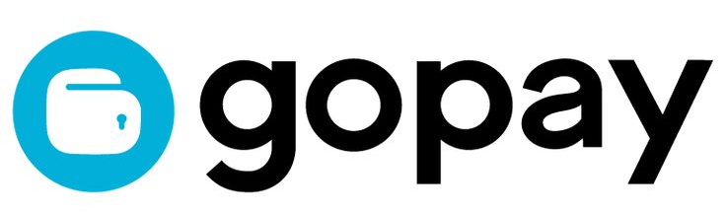
Competitive White Space
Incumbents compete on ecosystem lock-in; the underserved gap is trust, transparency, and cross-border utility for the urban professional segment
High
Client
The Premium Gap: Incumbents are focused on local, everyday spending, leaving the high-value cross-border market wide open for a specialized player.
Infrastructure Parity: Since QRIS is universal and affordable, merchant acceptance is no longer a competitive advantage—success depends on the user experience and unique/distinct features.
Regulatory shift creates opportunity: Strict new regulations have cleared out smaller, non-compliant competitors, creating a perfect entry point for a well-capitalized, compliance-focused firm.
Medium
Cross-border / Premium Capability
Low
Medium
High
Ecosystem Dependency
Don't compete with the incumbents on their own turf. Instead, position as the wallet for Indonesians who are mobile, professional, and cross-border. Focus on seamless SGD↔IDR transfers, build trust (digital wallet in use by 200,000 users in Singapore), compete on the experience layer rather than merchant network.
Sources: User engagement trends, Usage rates, Wallet share, GoPay statistics, Snapshot of top e-wallets in Indonesia, Top digital payment methods, Indonesia mobile wallet market assessment, MAUs
Prepared by – Sachin Garje

Slide 8
Positioning Rationale
Position the brand as the "Singapore-standard" digital wallet for the urban professional who values security and effortless cross-border transfers over domestic rewards
1
Cross-border Gap
(No wallet owns this space)
~20% of Indonesia's e-commerce sales in 2024 were cross-border — yet no wallet offers a purpose-built cross-border UX.
Cross-border QR interoperability is opening new tourist-spend corridors.
DANA's cross-border feature is nascent; GoPay and OVO have no cross-border offer for Indonesian users.
Client advantage: 200K Singapore users = live cross-border user base on Day 1
Trust Deficit
(Security is the #1 unmet need)
Fraud losses reached IDR 7 trillion between late 2024-2025, with OTP/SIM-swap representing 68% of cases.
Security ranked #1 improvement priority by GoPay, OVO and Dana users in satisfaction surveys.
Users prioritize security and reliability over all other factors in adoption intent studies.
Client advantage: MAS-regulated brand = institutional trust signal incumbents cannot credibly claim
2
3
Proven Technology
(Fintech firm registered in Singapore)
Singapore ranks 6th globally in Fintech Index 2025, and global investors prefer Singapore fintechs due to reliable regulation, strong compliance, and trusted IP protection.
Client already has 200,000 Singapore users and MAS licensing.
Client advantage: The positioning must be framed as ASEAN-native, Singapore-regulated — not as a Singapore company entering Indonesia.
For Indonesian professionals who live and work across borders, Client is the only financial-grade wallet that offers "Singapore-standard" security for everyday Indonesian transactions. Unlike local super-apps built for lifestyle services and rides, we provide a MAS-regulated, QRIS-native platform specialized in cross-border payments trusted by 200K users.
Sources: Figures on fraud losses, 2025 Analysis of payments and ecommerce trends, Study on user satisfaction in Indonesia’s e-wallet market, Study on Challenges and Perceptions, Study on adoption of e-wallet in Indonesia
Prepared by – Sachin Garje

Slide 9
Three channels cover the full urban acquisition funnel — E-commerce for scale, telco for reach, corporate for high-value retention — anchored by Alfamart
Integrate with E- & Social Commerce
Digital wallets that are integrated with e-commerce platforms have a greater likelihood of being used repeatedly.
E-commerce GMV exceeds $75B and social commerce is valued at $5B in 2024. Digital wallets are the #1 online payment method, above credit cards and COD.
Main Players – Shopee, TikTok, Tokopedia, Lazada, Instagram, Bukalapak
Anchor Partnership with Alfamart
Largest convenience store chain in Indonesia (22,000+ outlets)—provides physical presence and cash liquidity, which are vital for building trust in Indonesia.
Focus on Cash-In/Out and KYC Assistance
Users can top-up their wallets using cash or withdraw at any Alfamart counter
Alfamart staff act as human verifiers, scanning physical IDs to "Premium-verify" the user.
Alfamart charge a small admin fee IDR 2000-2500 per transaction for Cash-In/Out. Already partners with GoPay and OVO.
For assisted e-KYC, Alfamart might charge IDR 5-10K per user for successful verification.
Other options: Integrate wallet into Alfamart’s Point-of-Sale (POS) system for a one-time fee.
Co-Marketing: feature as preferred payment method in AlfaGift app or in-store promotion.
Partner with Telecom Providers
Use Telco data to simplify the “onboarding bottleneck" and prove the user's legitimacy bypassing KYC processes.
Integrate with Indosat’s "Smart Verify" or Telkomsel’s "MSIGHT." These tools use SIM-based data to verify a user's identity and financial reliability.
Main Players – Telkomsel, Indosat IM3, XL Axiata
Go-To-Market Channels
B2B2C Corporate Partnerships
Target Singapore-based company operating in Indonesia or employing Indonesian employees.
Offer the wallet as a corporate "perquisite" for employees who need to manage funds across both currencies (SGD/IDR).
Employees of cross-border firms are the highest-ARPU segment. This bypasses high acquisition costs by leveraging an existing employee base.
Sources: Top digital payment methods in Indonesia, 2025 analysis of payments and ecommerce trends, Ipsos digital wallet landscape in 2026, Indonesia’s digital market in 2026, GoPay-Alfamart, GoPay-AlfaGroup
Prepared by – Sachin Garje

Slide 10
Bank Indonesia's regulated MDR floor creates a near-level playing field — focus on cross border fees and value-added services to improve margins
Tiered Merchant Fee Model
Peer-to-Peer Transactions Fee Model
Merchant Tier | Transaction Size | MDR* Rate
Micro-enterprises (UMI) | < IDR 500,000 | 0%
Micro-enterprises (above threshold) | > IDR 500,000 upto 2M | 0.3%
Small businesses (UKE) | Any | 0.7%
Medium businesses (UME) | Any | 0.7%
Large businesses (UBE) | Any | 0.7%
Cross-border | Any | 0.7% + FX margin
P2P Type | Amount | Fee
Domestic P2P (same wallet) | Any | Free
Domestic P2P (inter-bank) | Any | IDR 2000-2500 flat
Cross-border P2P | Upto IDR 10M/txn | 0.5-1% + IDR 5K (flat)
Cash Top-up | Any | IDR 2500 per txn
Break-Even Point Analysis
The break-even sits at roughly ~5 million transactions per month — assuming an average transaction value of IDR 100,000 per month and fixed costs of IDR 1700M.
MDR revenue split is assumed to be 50-50% between wallet provider and other fees including Govt. admin/infra.
Because margin on payments are so low, most Indonesian wallets only break even by cross-selling high-margin products like BNPL, cross-border payments, micro-insurance or investment products.
Invest in building cross-border volume, where the FX margin is unregulated and 3–4× more valuable per transaction.
Bank Indonesia occasionally waives MDR for micro merchants which can help in user growth but makes the break-even target even harder to reach solely through fees.
*MDR=Merchant Discount Rate
Sources: GoPay Merchant - MDR QRIS tariff regulations
Prepared by – Sachin Garje

Slide 11
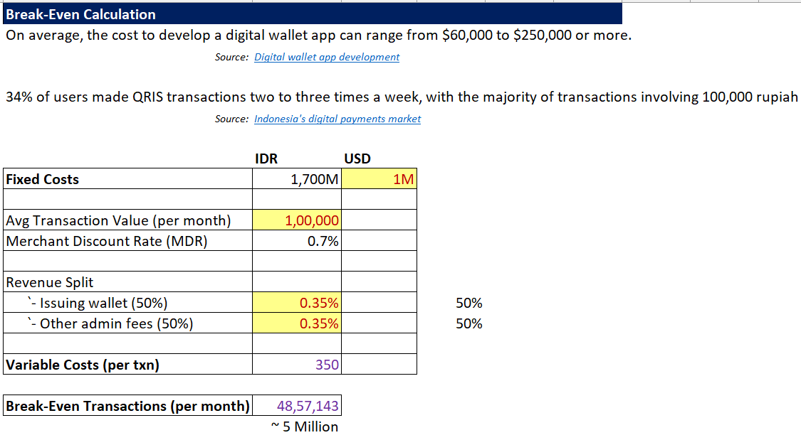
Snapshot from Excel Spreadsheet – Break Even Calculation
Prepared by – Sachin Garje

Slide 12
5 Key KPIs for First 6 Months
Build institutional trust early and prioritize transaction reliability to convert high-value cross-border users by Day 90
Activation Rate %
Target ≥ 45%
% of users who download the app and make first transaction
Transaction Success Rate %
Target ≥ 95%
No. of successful transactions vs errors/failures
Customer Acquisition Cost (CAC)
Target ≤ IDR 45K
Total expense a business incurs to convince a new customer to buy
Retention Rate %
Target ≥ 55%
% of users who are still active 30 days after their first transaction
Transaction Frequency
Target ≥ 8/month
Average number of transactions per active user per month
Days 1-30: Build the Foundation
Get legal, get live, get the first 10,000 users
Get OJK e-money license approved
QRIS integration live—Users can now pay at 30M+ merchants on Day 1
Activate Alfamart cash top-up at 5,000 outlets—for low-income users & first-time wallet adopters
Soft launch to 10,000 users via e-commerce checkout on Tokopedia/Shopee
Client–QRIS cross-border QR linkage — the SGD↔IDR transfer feature must be working from Day 1.
Days 30-60: Habit Formation
Scale to 100,000 users and prove they come back
Open public launch—run co-branded promotions on Shopee/Tokopedia mega-sale events
Enter partnership with telcos—wallet activation, simplify onboarding, bypass KYC processes
Close first 3 corporate partnerships—target Singapore-HQ firms operating in Jakarta
First retention campaign—push notification to users who activated but haven't transacted in 14 days. Offer a 2× cashback on their next txn.
Security trust campaign—explaining MAS regulated, fraud protection, address pain point #1 identified earlier.
Days 61-90: Own the Use Case
Hit 250,000 users & prove cross-border is the moat
Cross-border feature marketing push—targeted ads to Indonesian users in Singapore and to users with Singapore travel history; highest-ARPU segment
Alfamart expanded to full 22,000 outlets—Top-up availability nationwide is now a credibility signal
First KPI review with leadership—track & monitor all 5 KPIs against targets.
Merchant onboarding program—identify 500 priority merchants in Jakarta for premium wallet placement and co-marketing.
90-Day Launch Roadmap
Sources: Digital wallet app - complete guide, Financial KPIs for digital wallet, Core 5 KPIs of a digital wallet business, Pre-Launch mobile app metrics, Digital wallet app development
Prepared by – Sachin Garje

